Slide 1
EARTHQUAKE ALERTER
İLKNUR DENİZ BALOĞLU
MEHMET ÇINAR

Slide 2
The reasons why we chose this project: (Main reasons)
Earthquake is a common problem of all humanity.
01
We wanted to make a beneficial project for people as a life saver device.
02
We thought that if we choose this project, we can succeed at this difficult time.
03
It should have been a project where we could make improvements in the future.
04

Slide 3
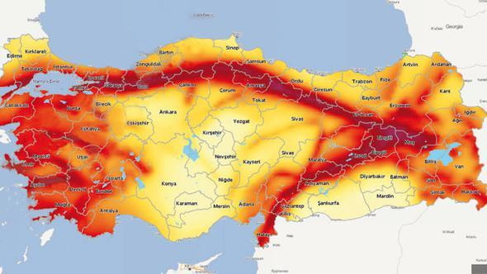
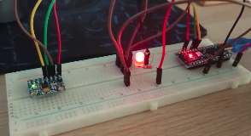
General View
Especially, we were inspired by our country which is in earthquake zone.
Our goal was to create a device that can respond against to earthquake shake with light and sound.

Slide 4
Then we started to make plan about this project step by step.
The SCHEDULE of EARTHQUAKE ALERTER
Decision Making Phase (with improvements and materials)
The Process of Gathering Materials (Approximately 10 days)
Generation of Circuit Design
Coding Phase
Circuit Design Error
The Updated Circuit Design and Coding

Slide 5
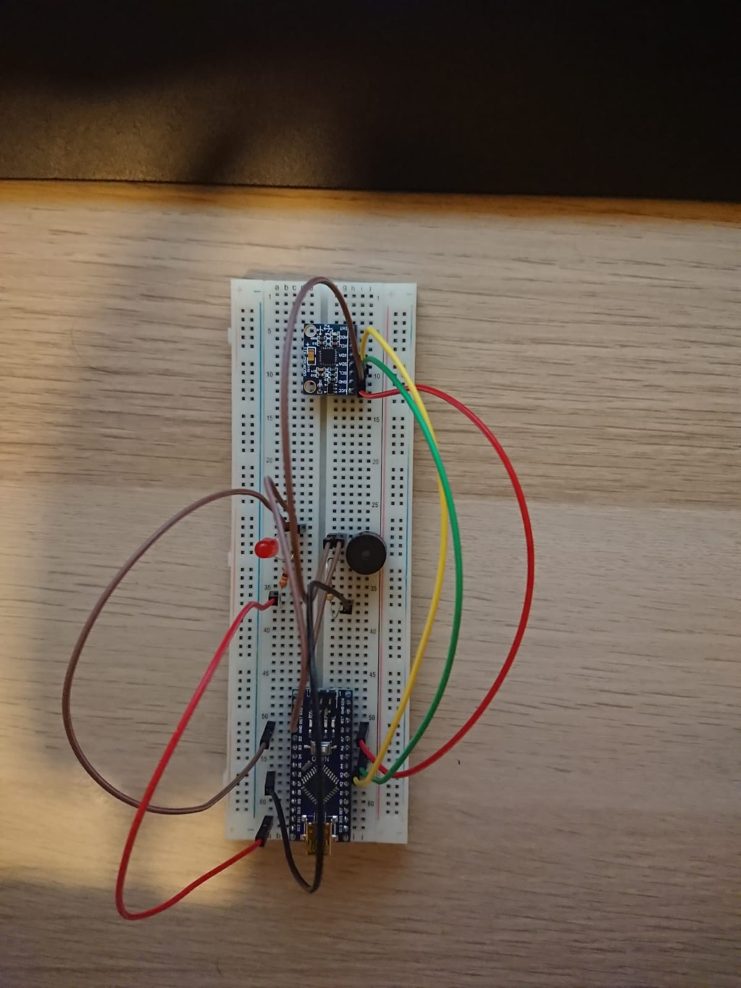
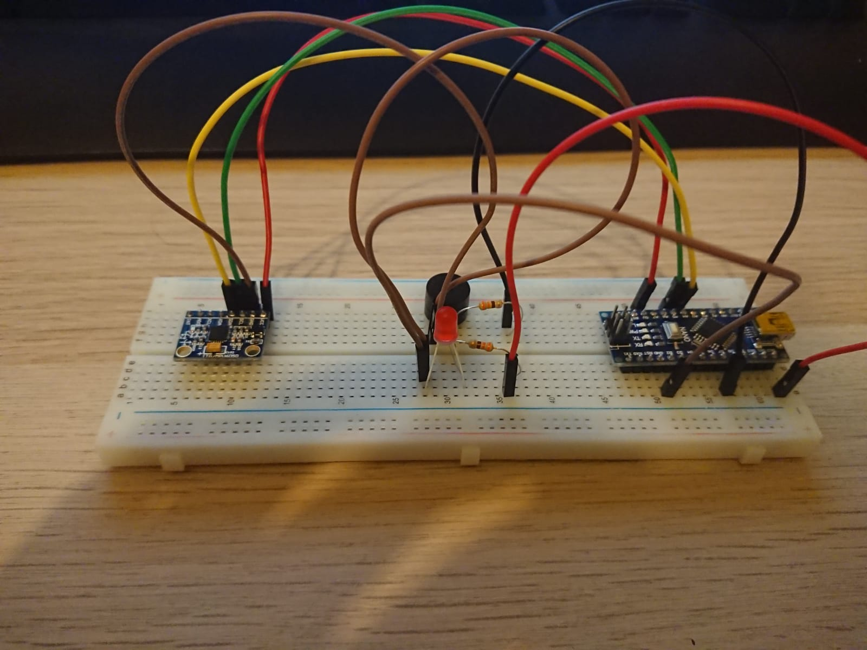
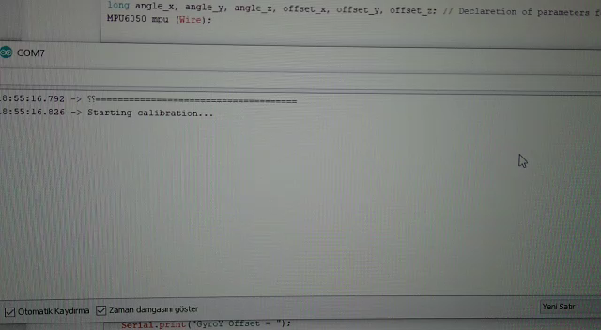
CIRCUIT

Slide 6
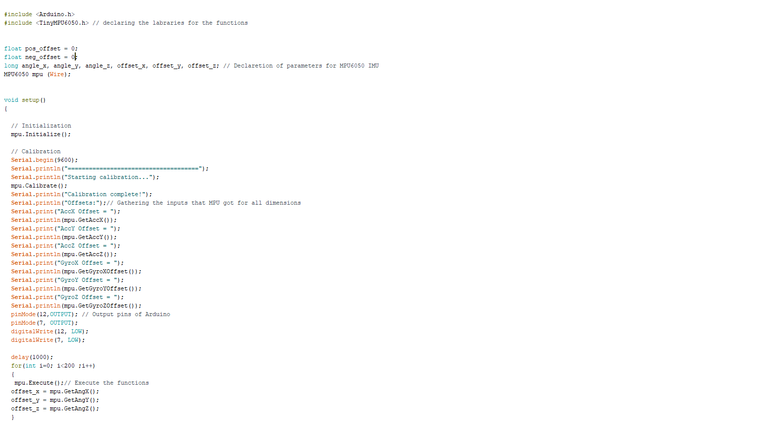
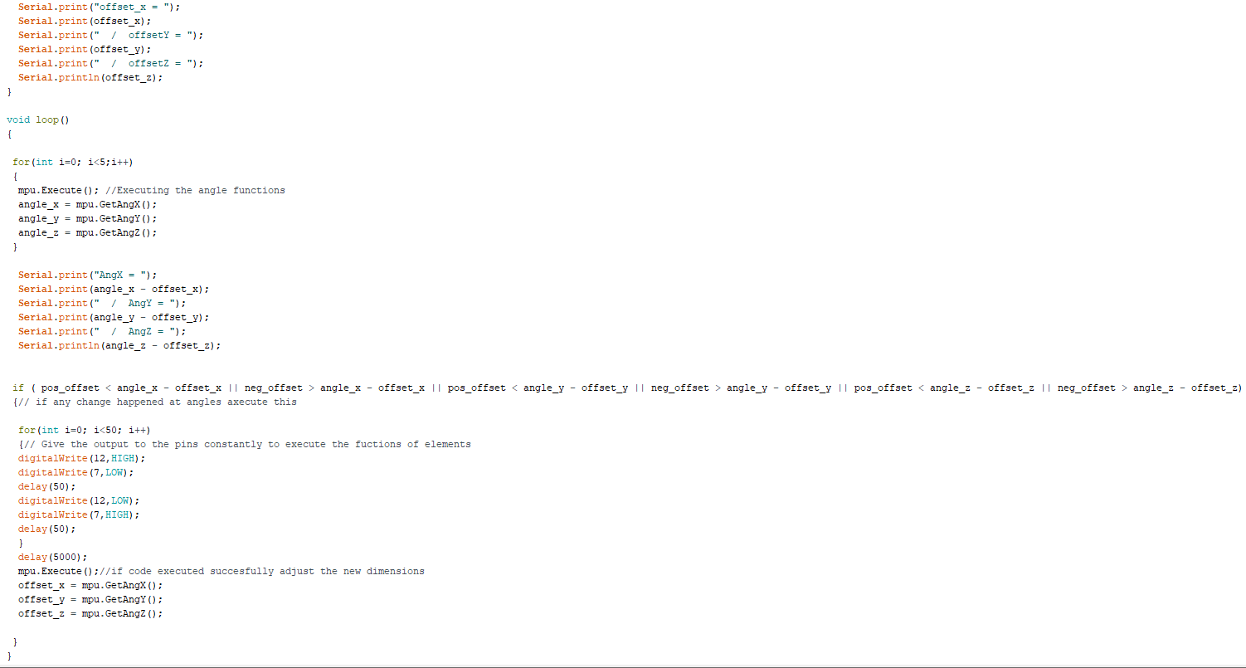
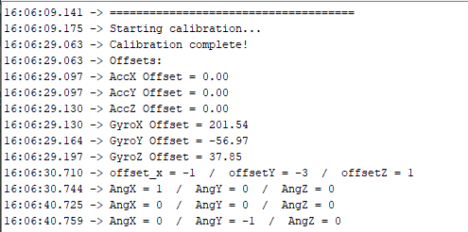
CODING

Slide 7
*We listed some problems about during the project preparation phase
Late and wrong product delivery
Distance factor
Timing problem

